Slide 1
Project week 3: Climate Change from Space
Phoebe Noble and Peter Berthelemy

Slide 2
Contents
What are satellites?
Why do we measure from space?
Real research in practise: e.g. whales from space project, penguins by poo,
Our example
Your task
Available tools

Slide 3
Your task – key points (the full brief can be found on moodle)
Group project of 5 people
Prepare a 7 minute presentation (3 minutes for questions) to be given as a group on Friday morning.
Use satellite data from ESA to ….?
We suggest starting by working through the examples in the lab script.

Slide 4
Tools:
ESA Climate Data set
MathWorks course on data processing and visualisation:
https://matlabacademy.mathworks.com/details/matlab-for-data-processing-and-visualization/mlvi
(This is 8 hrs long, you do not need to do it. It’s helpful for examples)
MATLAB help pages are your friend
Demonstrators will be available:
9am-11am (Mon-Thurs)
2-4pm (Mon, Tues, Thurs)

Slide 5
Think about defining some science questions?
How does my variable change at different times of year?
Is there a long term change (i.e. over 10 years) in the data?
Are there interesting ‘events’ to look at?

Slide 6
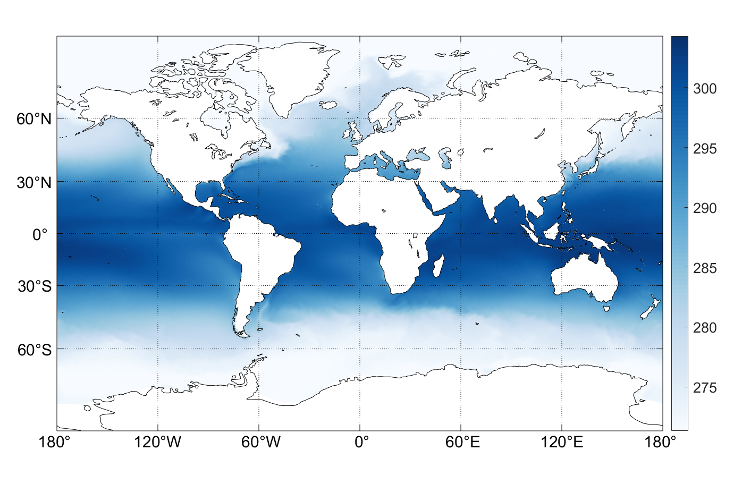
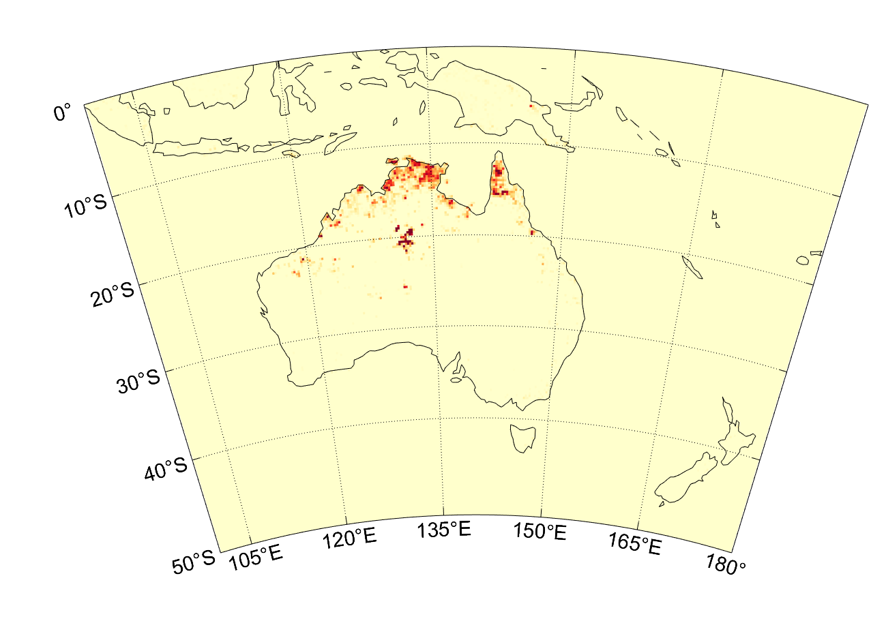
Sea surface temperature
FIRES!

